Slide 1
Chapter 6
Procedures and Functions

Slide 2
Topics
6.1 Procedures
6.2 Passing Arguments to Procedures
6.3 Functions
6.4 More about Debugging: Stepping Into, Over, and Out of Procedures and Functions
6.5 Focus on Program Design and Problem Solving: Building the Bagel and Coffee Price Calculator Application

Slide 3
Introduction
A procedure is a collection of statements that performs a task
Event handlers are a type of procedure
A function is a collection of statements that performs a task and returns a value to the part of the program that executed it
You have already worked with Visual Basic’s built-in functions, such as CInt and IsNumeric
A method can be either a procedure or a function

Slide 4
Procedures
6.1

Slide 5
Procedure Uses
An event handler is a type of procedure
Automatically executed when an event such as a mouse click occurs
General purpose procedures are triggered by statements in other procedures, not by events
Procedures help simplify & modularize code by:
Breaking it into small, manageable pieces
Performing a task that is needed repeatedly
Dividing a program into a set of logical tasks
Tutorial 6-1 examines an application with a procedure

Slide 6
Declaring a Procedure
The general format of a procedure declaration is as follows:
AccessSpecifier is optional and establishes accessibility to the program
Sub and End are keywords
ProcedureName used to refer to procedure
Use Pascal casing to capitalize 1st character of the name and each new word in the name
ParameterList is a list of variables or values being passed to the sub procedure
A parameter is a special variable that receives a value being passed into a procedure
Tutorial 6-2 guides you through the process of writing procedures
[AccessSpecifier] Sub ProcedureName ([ParameterList])
[Statements]
End Sub

Slide 7
Passing Arguments to Procedures
6.2

Slide 8
Arguments
An argument is value passed to a procedure
For example:
Calls the CInt function
Passes txtInput.Text as an argument
Two ways to pass arguments:
by value
Temporary copy of the original argument
by reference
The original argument and can be changed
CInt(txtInput.Text)

Slide 9
Passing Arguments by Value
DisplayValue(5) ' Call DisplayValue procedure
Sub DisplayValue(ByVal intNumber As Integer)
' This procedure displays a value in a message box.
MessageBox.Show(intNumber.ToString)
End Sub
intNumber declared as an integer argument
Storage location intNumber created by procedure
A value, 5 in this case, must be supplied and is copied into the storage location for intNumber
The DisplayValue procedure then executes
Tutorial 6-3 demonstrates passing arguments

Slide 10
Passing Multiple Arguments
ShowSum(intValue1, intValue2) ' Call ShowSum procedure
Sub ShowSum(ByVal intNum1 As Integer, ByVal intNum2 As Integer)
Dim intSum As Integer 'Local variable to hold a sum
'Get the sum of the two arguments.
intSum = intNum1 + intNum2
'Display the sum.
MessageBox.Show("The sum is " & intSum.ToString())
End Sub
Multiple arguments separated by commas
Value of first argument is copied to first
Second to second, etc.

Slide 11
More about Passing Arguments by Reference
Arguments are usually passed ByVal
New storage location created for procedure
Storage location gets a copy of the value
Any changes in value are made to the copy
Calling procedure won’t “see” the changes
Arguments can also be passed ByRef
Procedure points to (references) argument’s original storage location
Any changes are made to the original value
Calling procedure “sees” the changes
Tutorial 6-4 demonstrates the difference between ByVal and ByRef

Slide 12
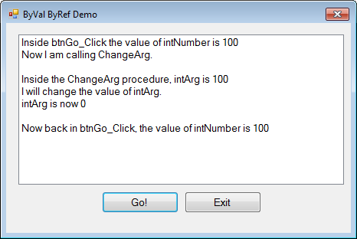
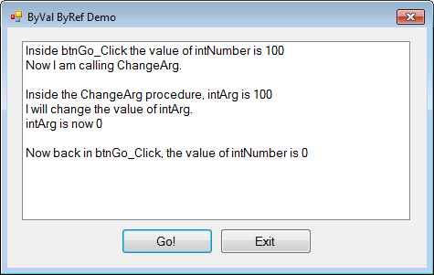
Working with ByVal and ByRef
Passing the argument ByVal
Does not change the value of intNumber
Passing the argument ByRef
Allows the value of intNumber to change

Slide 13
Functions
6.3

Slide 14
Declaring a Function
New keyword Function
Also new is As DataType which states the data type of the value to be returned
Return value is specified in a Return expression
[AccessSpecifier] Function FunctionName ([ParameterList]) As DataType
[Statements]
End Function

Slide 15
Function Call Example
dblTotal = Sum(dblValue1, dblValue2)
Function Sum(ByVal dblNum1 As Double, ByVal dblNum2 As Double)
As Double
Return dblNum1 + dblNum2
End Function
The Sum function
Passes the variables dblValue1 and dblValue2 as arguments
Data types must agree with parameter list
Assigns the value returned by the Sum function to the variable dblTotal, agrees with return value
Tutorial 6-5 demonstrates function use

Slide 16
Returning Nonnumeric Values
Functions can return nonnumeric values, such as strings and Boolean values
strCustomer = FullName("John", "Martin")
Function FullName(ByVal strFirst As String,
ByVal strLast As String) As String
' Local variable to hold the full name
Dim strName As String
' Append the last name to the first
' name and assign the result to strName.
strName = strFirst & " " & strLast
' Return the full name.
Return strName
End Function

Slide 17
More about Debugging: Stepping Into, Over, and Out of Procedures and Functions
6.4

Slide 18
The Step Into Command
The Step Into command
Continue to debug by single-stepping through a procedure
Press the F8 key
Select DEBUG from the menu bar, and then select Step Into from the DEBUG menu
Click the Step Into button on the Debug Toolbar, if the toolbar is visible
Tutorial 6-6 demonstrates the Step Into command

Slide 19
The Step Over Command
The Step Over command
Run procedure without single-stepping, continue single-step after the call
Press the Shift + F8 key
Select DEBUG from the menu bar, and then select Step Over from the DEBUG menu
Click the Step Over button on the Debug Toolbar, if the toolbar is visible
Tutorial 6-7 demonstrates the Step Over command

Slide 20
The Step Out Command
The Step Out command
End single-stepping in procedure, continue single-step after the call
Press the Ctrl + Shift + F8 key
Select DEBUG from the menu bar, and then select Step Out from the DEBUG menu
Click the Step Out button on the Debug Toolbar, if the toolbar is visible
Tutorial 6-8 demonstrates the Step Out command

Slide 21
Focus on Program Design and Problem Solving: Building the Bagel and Coffee Price Calculator Application
6.5

Slide 22
Overview
The owner of Brandi’s Bagel House has asked you to write an application that her staff can use to record an order as it is called in
Customers may call in and order
White and whole wheat bagels with a variety of toppings
Three different types of coffee
The application should display
The total of the order, including 6% sales tax
Bagels:
White bagel $1.25
Whole wheat bagel $1.50
Toppings:
Cream cheese $0.50
Butter $0.25
Blueberry jam $0.75
Raspberry jam $0.75
Peach jelly $0.75
Coffee:
Regular coffee $1.25
Cappuccino $2.00
Café au lait $1.75
(Note: Delivery for coffee alone is not offered.)

Slide 23
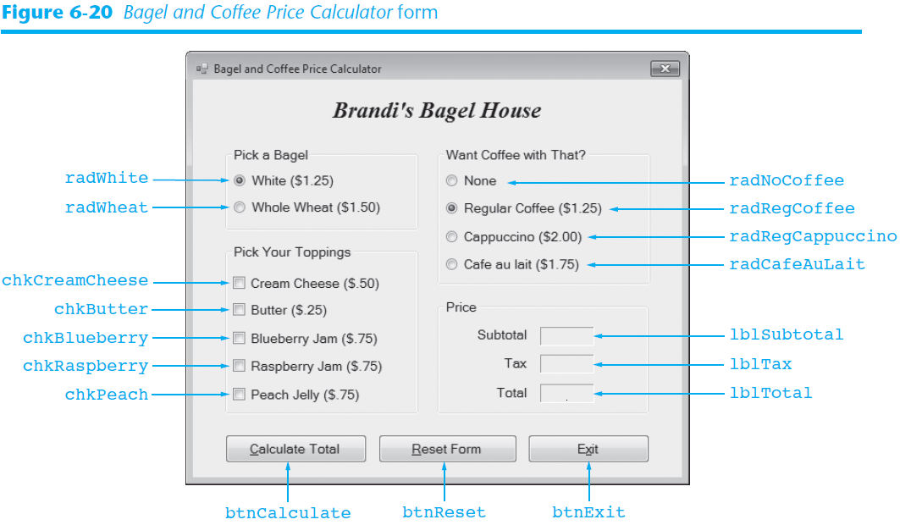
The Form and Controls

Slide 24
Description of Click Event Handlers
Name | Description
btnCalculate_Click | Calculates and displays the total of an order Calls the following functions: BagelCost, CoffeeCost, ToppingCost, and CalcTax
btnExit_Click | Ends the application
btnReset_Click | Resets the controls on the form to their initial values Calls the following procedures: ResetBagels, ResetToppings, ResetCoffee, and ResetPrice

Slide 25
btnCalculate_Click Pseudocode
Calculates the total of an order and displays its price
subtotal = BagelCost() + ToppingCost() + CoffeeCost()
tax = CalcTax(subtotal)
total = subtotal + tax
lblSubtotal.Text = subtotal
lblTax.Text = tax
lblTotal.Text = total

Slide 26
btnReset_Click Pseudocode
Resets all the radio buttons, check boxes, and labels
ResetBagels()
ResetToppings()
ResetCoffee()
ResetPrice()

Slide 27
Description of Functions
Name | Description
CalcBagelCost | Returns the price of the selected bagel
CalcToppingCost | Returns the total price of the selected toppings
CalcCoffeeCost | Returns the price of the selected coffee
CalcTax | Accepts the amount of a sale as an argument Returns the amount of sales tax on that amount The tax rate is stored in a class-level constant, decTAX_RATE

Slide 28
CalcBagelCost Function Pseudocode
Determines whether the user has selected white or whole wheat and returns the price of that selection
If White Is Selected Then
cost of bagel = 1.25
Else
cost of bagel = 1.5
End If
Return cost of bagel

Slide 29
CalcToppingCost Function Pseudocode
Examines the topping check boxes to determine which toppings the user has selected
Returns the total topping price
cost of topping = 0.0
If Cream Cheese Is Selected Then
cost of topping += 0.5
End If
If Butter Is Selected Then
cost of topping += 0.25
End If
If Blueberry Is Selected Then
cost of topping += 0.75
End If
If Raspberry Is Selected Then
cost of topping += 0.75
End If
If Peach Is Selected Then
cost of topping += 0.75
End If
Return cost of topping

Slide 30
CalcCoffeeCost Function Pseudocode
Examines the coffee radio buttons to determine which coffee (if any) the user has selected
Returns the price
If No Coffee Is Selected Then
cost of coffee = 0
ElseIf Regular Coffee Is Selected Then
cost of coffee = 1.25
ElseIf Cappuccino Is Selected Then
cost of coffee = 2
ElseIf Café Au Lait Is Selected Then
cost of coffee = 1.75
End If
Return cost of coffee

Slide 31
CalcTax Function Pseudocode
Accepts as an argument, the amount parameter variable
Tax rate will be stored in a class-level constant
Returns the amount of sales tax
sales tax = amount * tax rate
Return sales tax

Slide 32
Description of Procedures
Name | Description
ResetBagels | Resets the bagel type radio buttons to their initial value
ResetToppings | Resets the topping check boxes to unchecked
ResetCoffee | Resets the coffee radio buttons to their initial values
ResetPrice | Sets the Text property of the lblSubtotal, lblTax, and lblTotal labels to String.Empty

Slide 33
ResetBagels Procedure Pseudocode
Resets the bagel radio buttons to their initial values
radWhite = Selected
radWheat = Deselected

Slide 34
ResetToppings Procedure Pseudocode
Unchecks all the toppings check boxes
chkCreamCheese = Unchecked
chkButter = Unchecked
chkBlueberry = Unchecked
chkRaspberry = Unchecked
chkPeach = Unchecked

Slide 35
ResetCoffee Procedure Pseudocode
Resets the coffee radio buttons to their initial values
radNoCoffee = Deselected
radRegCoffee = Selected
radCappuccino = Deselected
radCafeAuLait = Deselected

Slide 36
ResetPrice Procedure Pseudocode
Copies an empty string to lblSubtotal, lblTax, and lblTotal
In Tutorial 6-9, You build the Bagel House Application
lblSubtotal.Text = String.Empty
lblTax.Text = String.Empty
lblTotal.Text = String.Empty

